Slide 1

University Institute of Liberal Arts and Humanities
Course Name: Communication Skills
Course Code: 23PCH-105
onjbjjnjnjnjdbj
ONE-WORD SUBSTITUTIONS
DISCOVER . LEARN . EMPOWER

Slide 2
COURSE OBJECTIVES
The Course aims to:
1 | Augment students overall communication and interpersonal skills by making them realize the importance of good oral and written English Language in professional life.
2 | Enrich their reading capability with special emphasis on expanding vocabulary and grammatical formations.
3 | Build exceptional speaking, reading and writing skills by correcting grammatical errors and pronunciation through practice.
4 | Enhances soft skills by fostering self awareness, confidence and a positive attitude in students’ ability to communicate effectively in English.

Slide 3
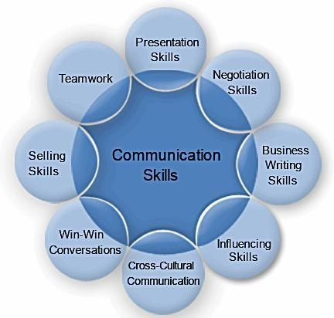
COURSE OUTCOMES
The students are expected to
CO Number | Title | Level
CO1 | Apply appropriate Listening, Speaking, Reading and Writing Skills (LSRW Skills) with correct non-verbal cues to attain expertise in soft skills. | Apply
CO2 | Apply correct contextual and comprehensible written text in the form of paragraph writing, short compositions business correspondence, using logical support and argument in a wide range of communication situations. | Apply
CO3 | Demonstrate linguistic competence while speaking and during presentations through accuracy in grammatical usage, vocabulary, pronunciation and intonation. | Apply
CO4 | Evaluate information as critical readers, speakers and writers applying ethics in communication and being sensitive in cross cultural communication. | Evaluate
CO5 | Create original, digital content for websites, blogs, vlogs and personal social media profiles etc. | Create
Dreamstime.com

Slide 4

One word substitutions
One word substitution is a procedure where a single word is supplanted to a tedious expression, to make the sentence structure all the more clear.
Dreamstime.com

Slide 5
The technique to be used
The technique for doing one word substitution is to use the root method.
Look at the root word - CRACY.
1. CRACY = RULE / GOVERNMENT
A government by the people - Democracy
A government by the officials - Bureaucracy
A government by the rich – Plutocracy
A government by the nobles - Aristocracy

Slide 6

Omni= All
One who is all powerful - Omnipotent
One who is present everywhere - Omnipresent
One who knows everything - Omniscient
Dreamstime.com

Slide 7
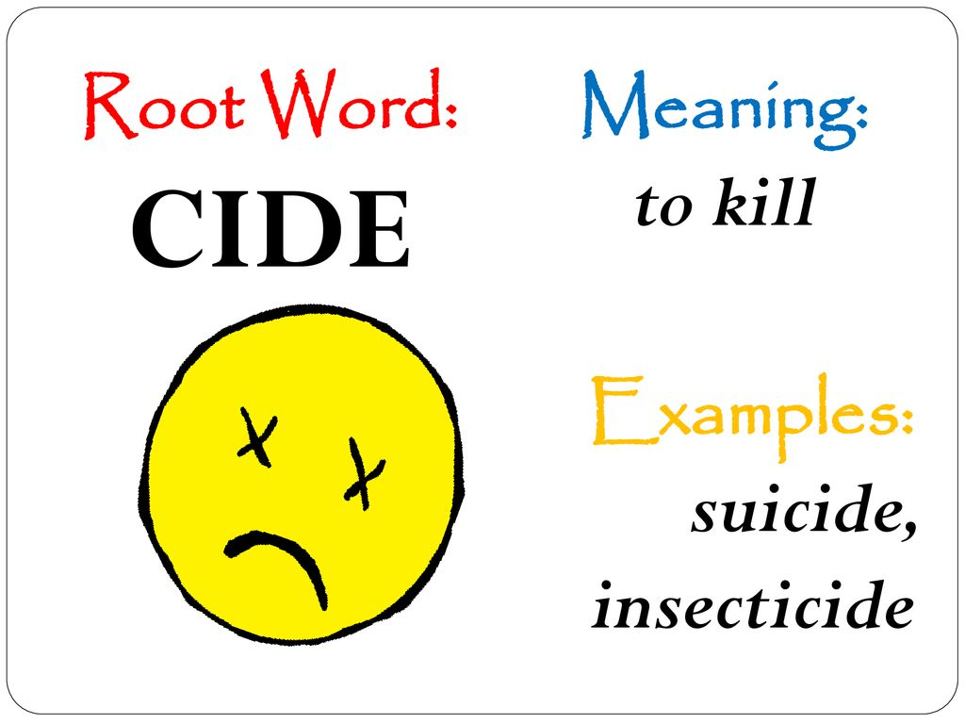
CIDE= KILLING
Killing of a human being - Homicide
Killing/ Murder of a king - Regicide
Killing of an Infant/ newborn baby - Infanticide
Killing of a race or community - Genocide
Killing of One's sister - Sororicide
Proprofs.com

Slide 8

Ible= Able to be
Inaudible - a sound that cannot be heard
Inaccessible - that cannot be easily approached
Incorrigible - incapable of being corrected
Irreparable - incapable of being repaired
Illegible - incapable of being read
Careertimes.com

Slide 9
Some More Examples
A person leaving his native country to settle in another – Emigrant
A person coming to a foreign land to settle there – Immigrant
A person living in a foreign country – Alien/foreigner
A person who is voluntarily absent from home or country – expatriate
A person looking only to the dark side of things – Pessimist
A person looking only to the bright side of things- Optimist

Slide 10
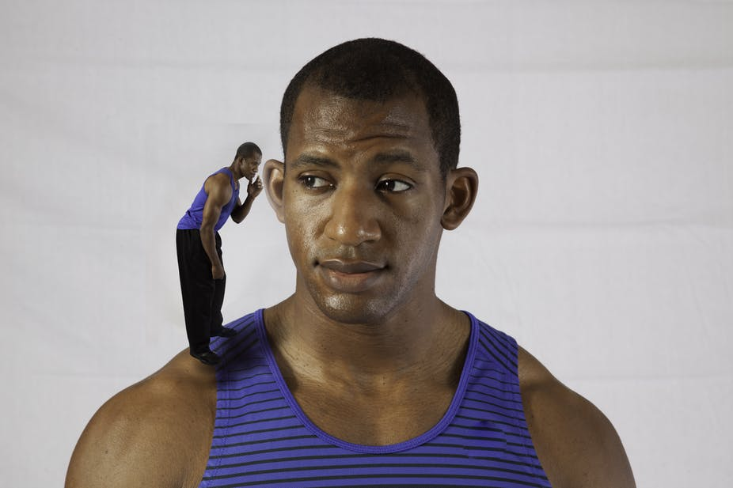
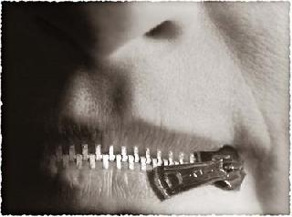
Exercise
1. A person who thinks only of himself
2. A person who speaks less
slideshare.com
slideshare.com

Slide 11

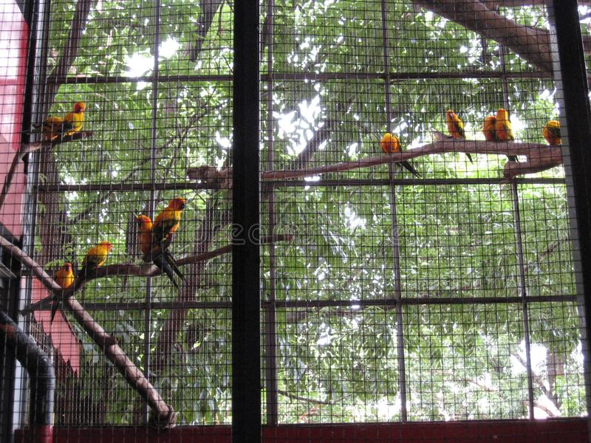
3. People travel on foot
4. A place where the birds are kept
proprofs.com
Proprofs.com

Slide 12
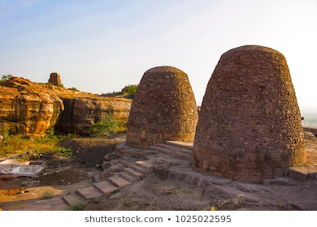

5. A place of storing grain
6. A road with trees on both sides
Dreamstime.com
Dreamstime.com

Slide 13
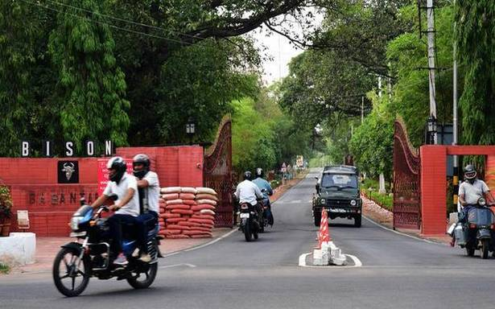
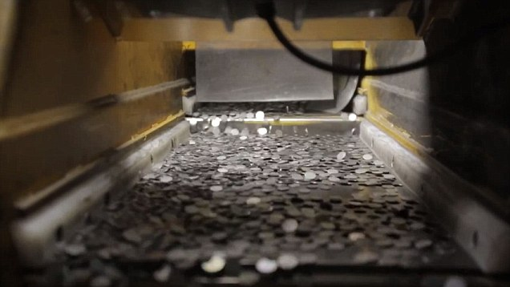
7. A place given to soldiers to live
8. A place where coins are made
Careerpath.com
Careerpath.com

Slide 14

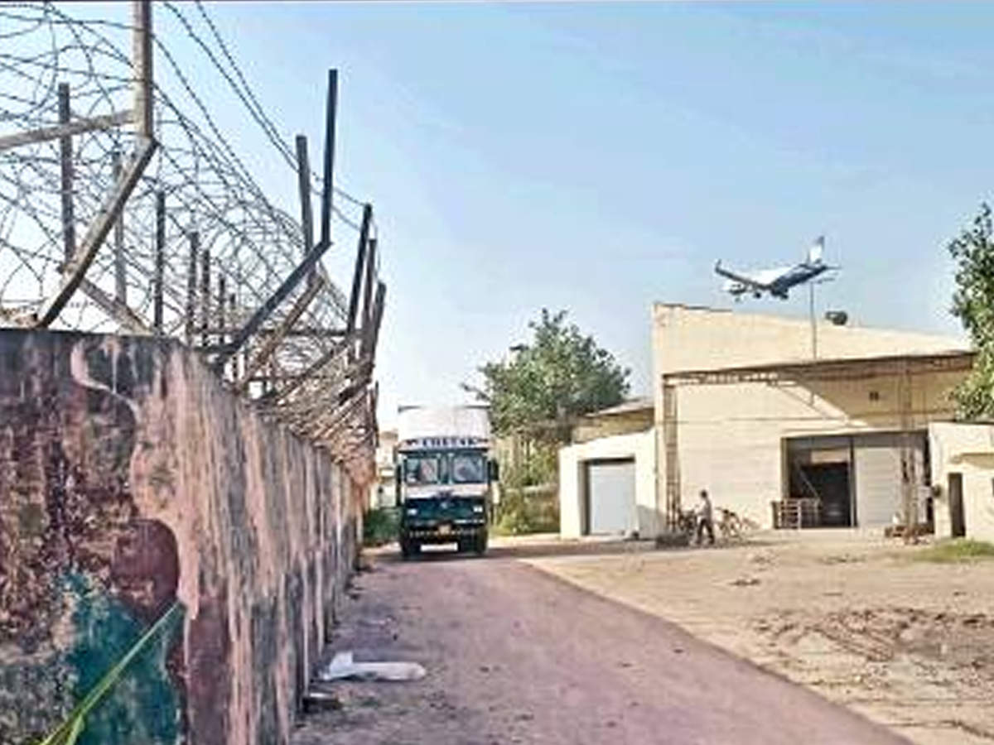
Answers
1. Egoistic
2. Reticent
3. Pedestrian
4. Aviary
5. Granary
6. Avenue
7. Cantonment
8. Mint
Dreamstime.com

Slide 15
Applications
Helps in making communication effective.
Reduces ambiguity in language.
Helps make text more clear and comprehensible.

Slide 16
Assessment Pattern
Students are assessed on the basis of the following parameters:
Hourly Test – 2
Assignments
Surprise Test
Quiz
End Semester Exam

Slide 17
References
https://www.hitbullseye.com/Vocab/One-Word-Substitution.php
file:///C:/Users/LAPTOP%20ADDA/Downloads/onewordsubstitution-170201152425.pdf
https://books.google.co.in/books?id=GMEwBQAAQBAJ&printsec=frontcover#v=onepage&q&f=false
https://7esl.com/synonyms/#Synonyms
https://prajwalarao.files.wordpress.com/2011/08/synonym_antonym_questions_prsolutions2.pdf

Slide 18
THANK YOU
For queries
Email: communicationskills.uilah@gmail.com

